Slide 1




Microfrontends
with
Florian Rappl

Slide 2

Hello, I’m Florian!
Solution Architect at smapiot
IoT / Embedded Computing
Digital Transformation
Distributed Web Applications
Open-Source Enthusiast
Microsoft MVP Development Tools
Projects for .NET and JS
Articles for various blogs and magazines
Notes:
Florian
Talk Points
1. Use custom JS bridge (forked) w/o location change
2. Projection of DOM components (VDOM -> Blazor:source DOM -> Portal:target DOM)
3. Dynamic registration of components (incl. activation)
4. Dynamic library loading (after startup)
5. Allow routing and extension methods of Piral (framework interop)
6. Define final architecture for reusability
7. Provide project template for consumption

Slide 3
System Architecture Example
Frontend
Monolithic architecture
Integrated and consistent user experience
Developed by one central team
Larger deployment releases
Single Frontend Solution
Microservices
Scoped around business capabilities
Developed by autonomous teams
Own development & deployment lifecycle
Loosely coupled
Technology independent
Service A
Service B
Service C
Service X
Service Y

Slide 4
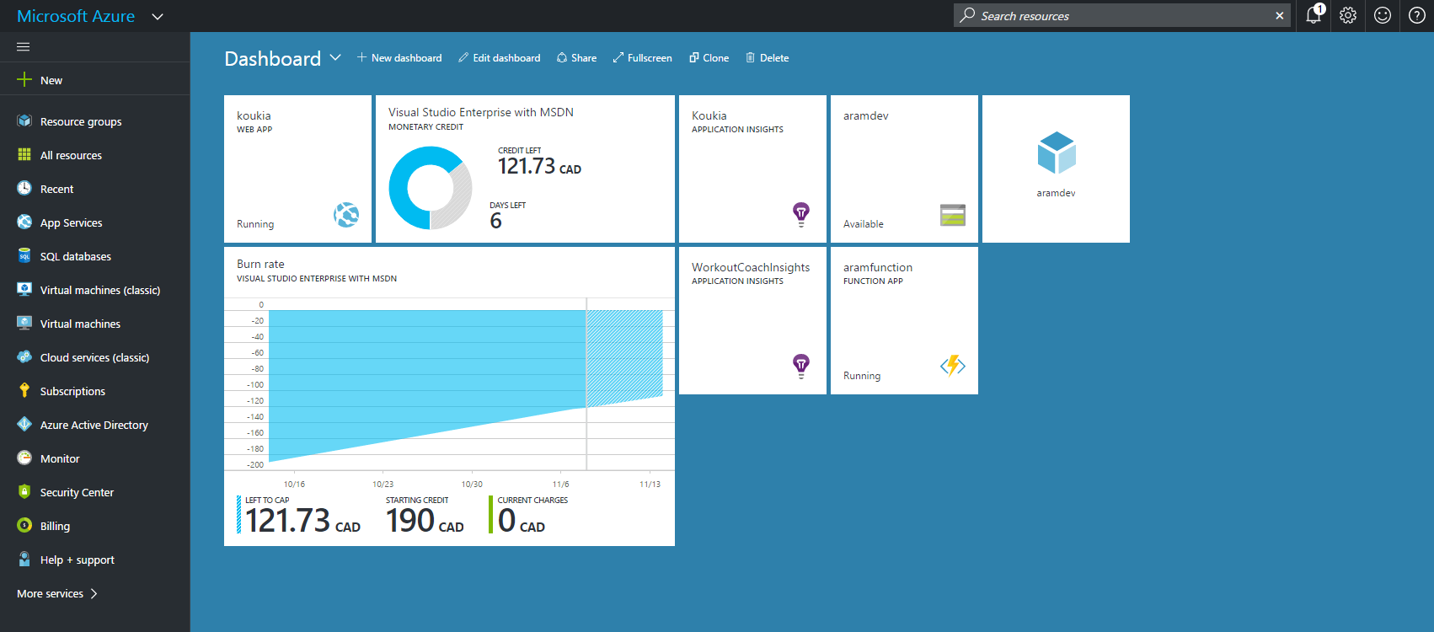

Slide 5
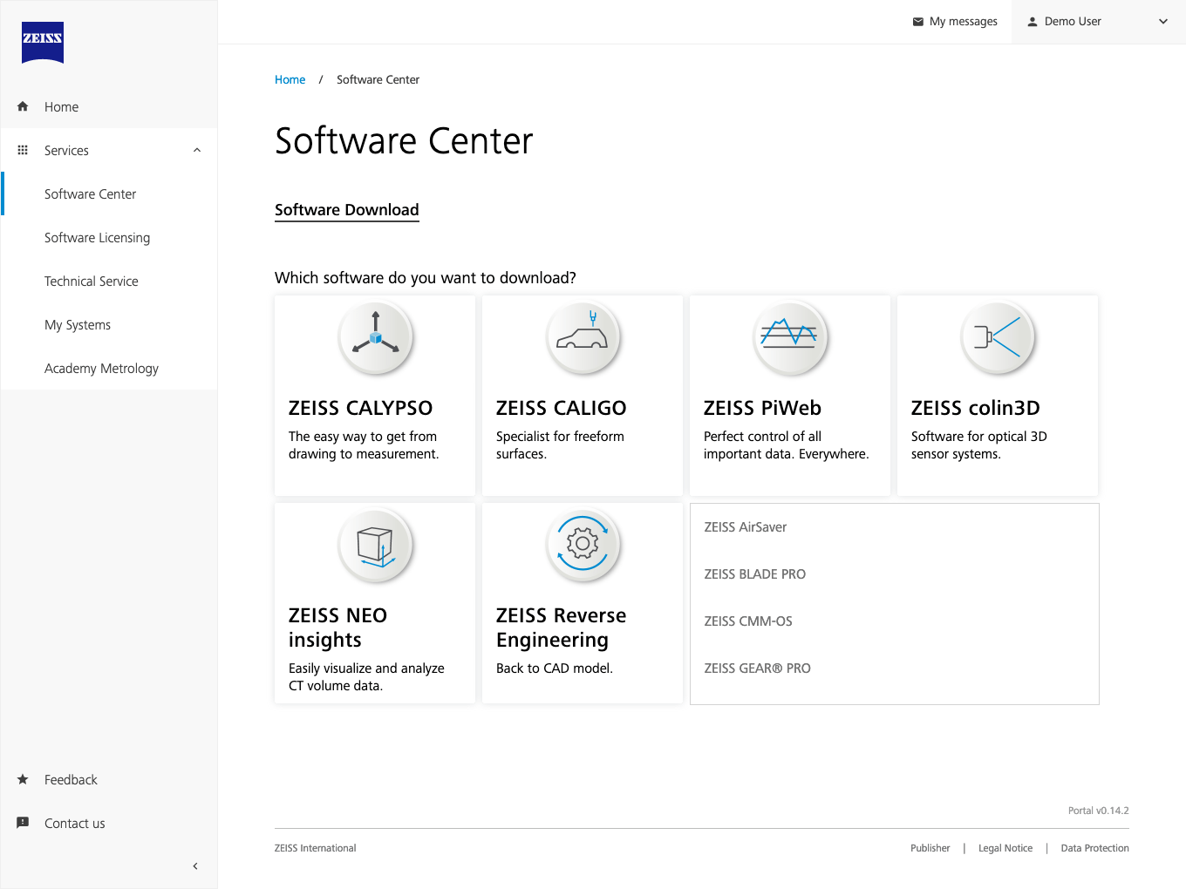
* this is not actually Blazor, but you get the idea

Slide 6
Microfrontend Architecture

Slide 7
Microfrontend Architecture
Distributed Web Application
Frontend
Frontend A
Frontend B
Frontend C
Frontend D
Microfrontend
Backend
Service A
Service B
Service C
Service D
Microservice

Slide 8
Proposed Frontend Architecture
Modular Distributed Web Application
Distributed Web Application
Frontend
Core and Common Capabilities
Frontend D
App Shell Component
Frontend C
Module D
Frontend B
Module C
Frontend A
Module B
Shared Libraries
Module A
Pattern Library
Business Capability Module
Backend
Service A
Service B
Service C
Service D
Microservice

Slide 9

Natural Web App Evolution
Monolith
Sep. BE/FE
Microservices
Microfrontends
Single
System
(FE+BE)
FE
(SPA)
FE
(SPA)
1
2
N
App Shell
BE
(API)
Gateway
Gateway
1
2
N
1
2
N

Slide 10

Options in Blazor (WASM)

Slide 11

Use NuGet Packages
Modular Distributed Web Application
Blazor WASM App
Lib A
Lib B
Lib C
Lib D
Used Libs
Design Lib

Slide 12
Use NuGet Packages
✅ Stays in the flow
✅ C# all the way
❌ Requires recompilation
❌ No cross-framework support
❌ Needs full evaluation before starting

Slide 13
Demo Blazor Distributed

Slide 14
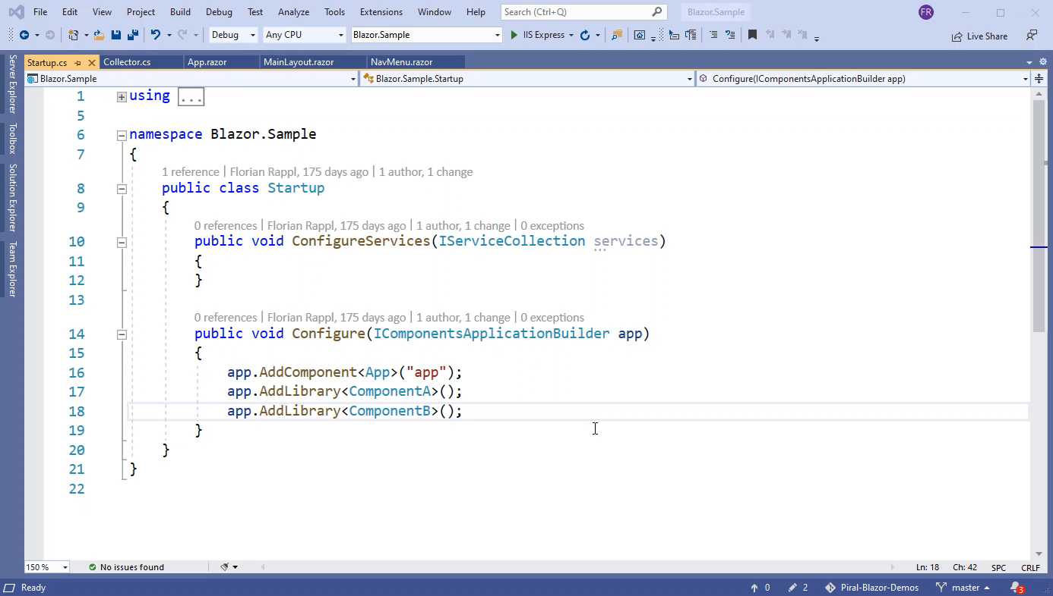

Slide 15
Combine with JS
✅ Recombine freely
✅ Allows using other frameworks
✅ Enables lazy loading of Blazor code
❌ Difficult to publish correctly
❌ Requires JS and C# parts

Slide 16
Challenges Blazor Microfrontend Solution

Slide 17
Challenge 1: Routing

Slide 18
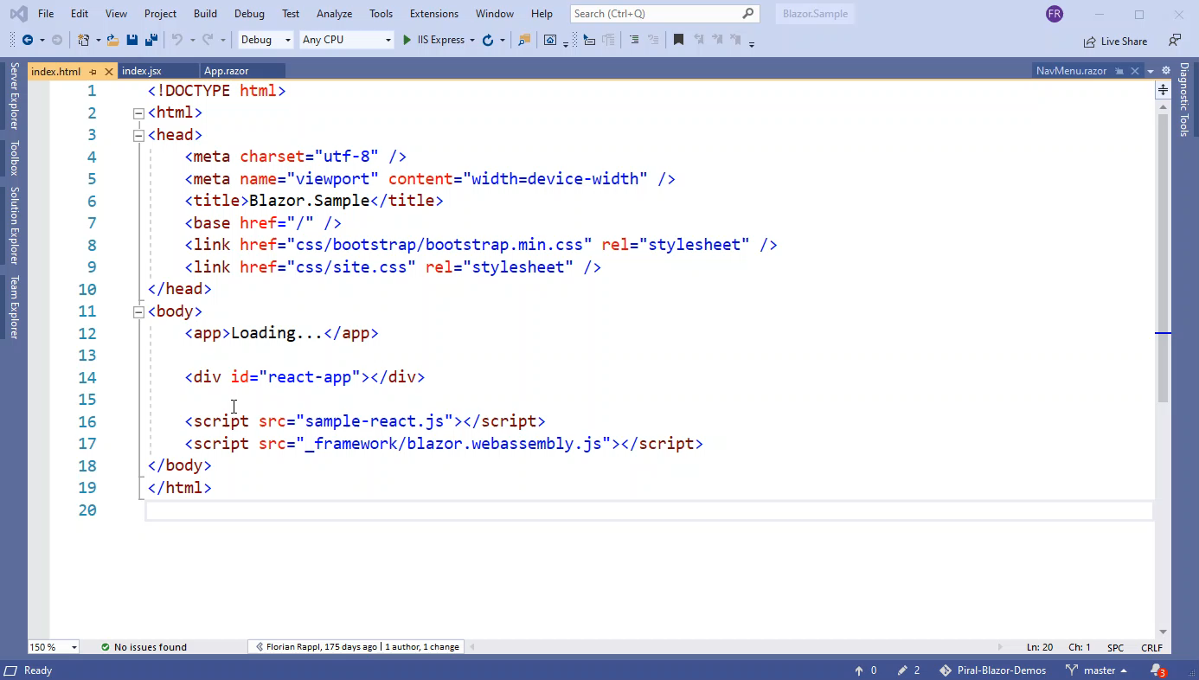

Slide 19
Challenge 2: DOM Projection

Slide 20
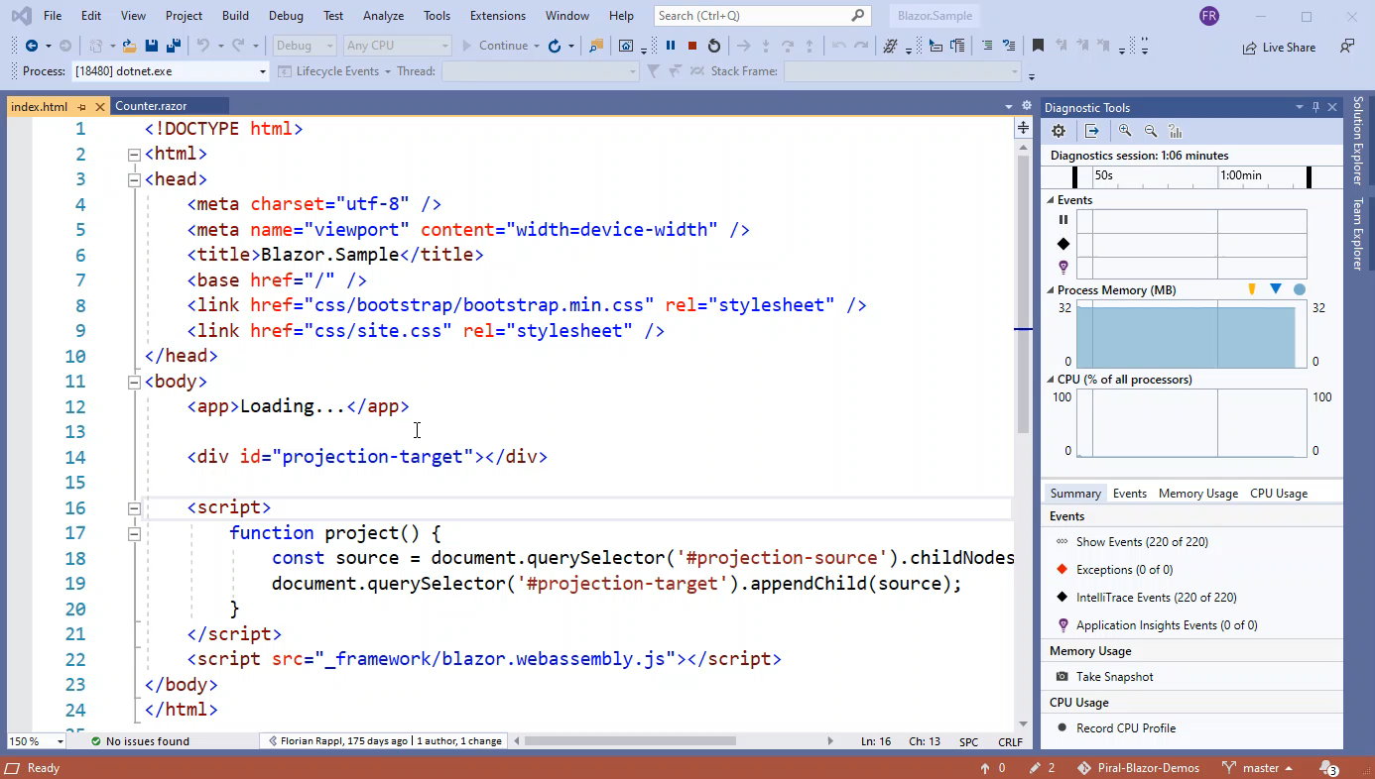

Slide 21
Challenge 3: Dynamic Registration

Slide 22
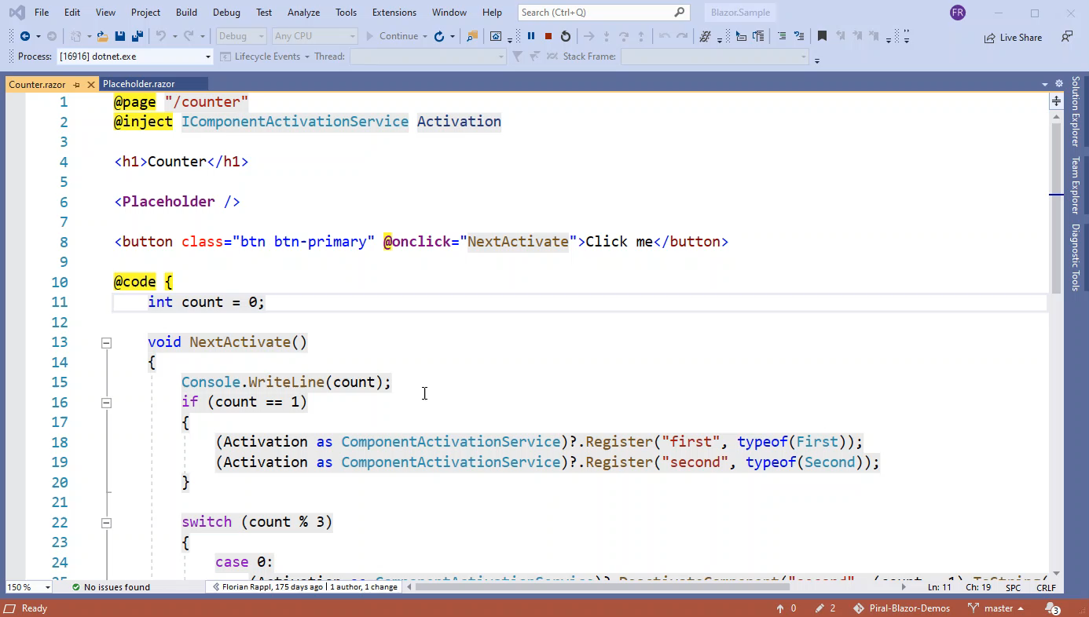

Slide 23
Challenge 4: Using Shared Components

Slide 24
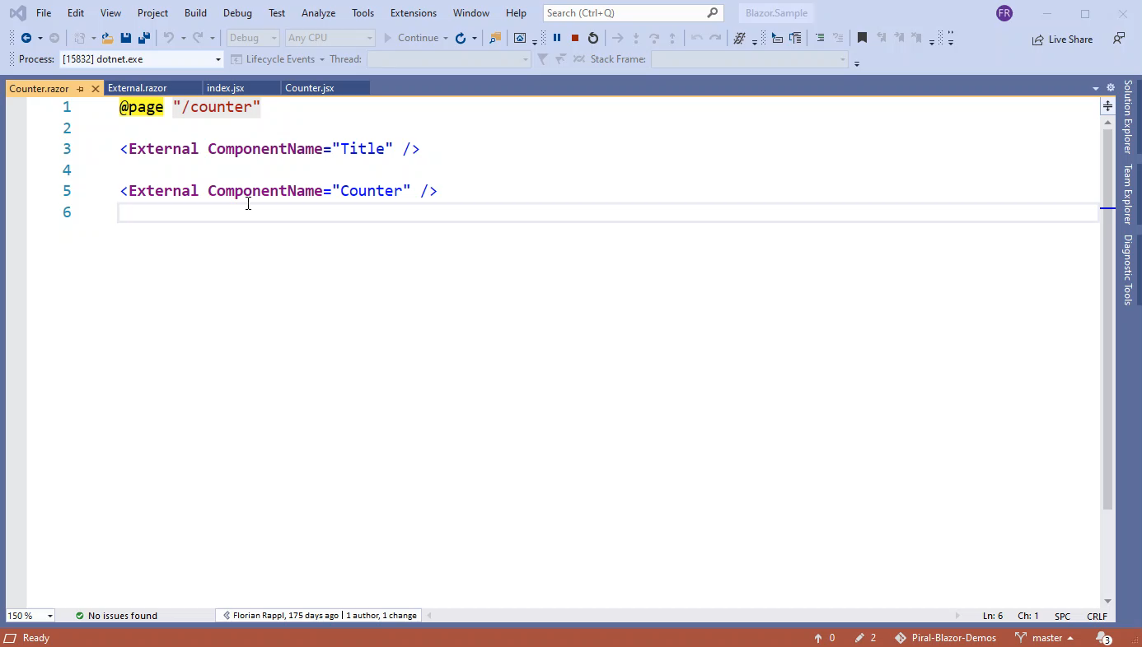

Slide 25
Challenge 5: Lazy Loading Solved in .NET 5 / Blazor 5: https://docs.microsoft.com/en-us/aspnet/core/blazor/webassembly-lazy-load-assemblies?view=aspnetcore-5.0

Slide 26
Reference Implementation (Sources: https://github.com/piral-samples/azure-static-web-app)

Slide 27
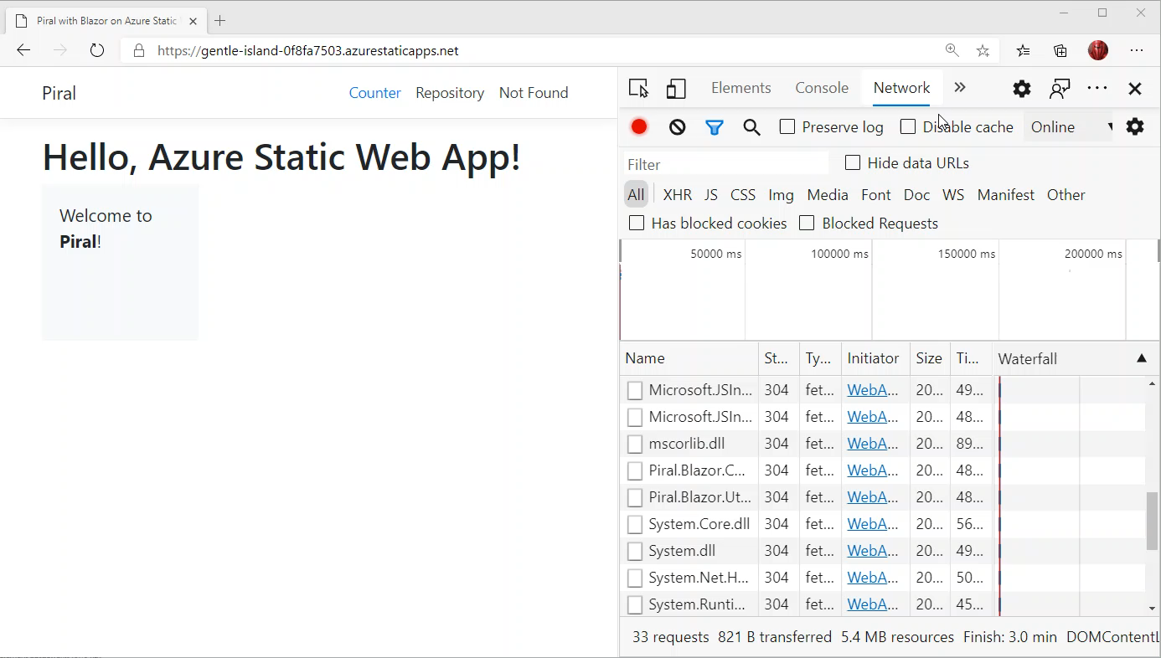

Slide 28

a framework for
modular distributed
Microfrontends
https://piral.io
https://docs.piral.io
https://github.com/smapiot/piral

Slide 29
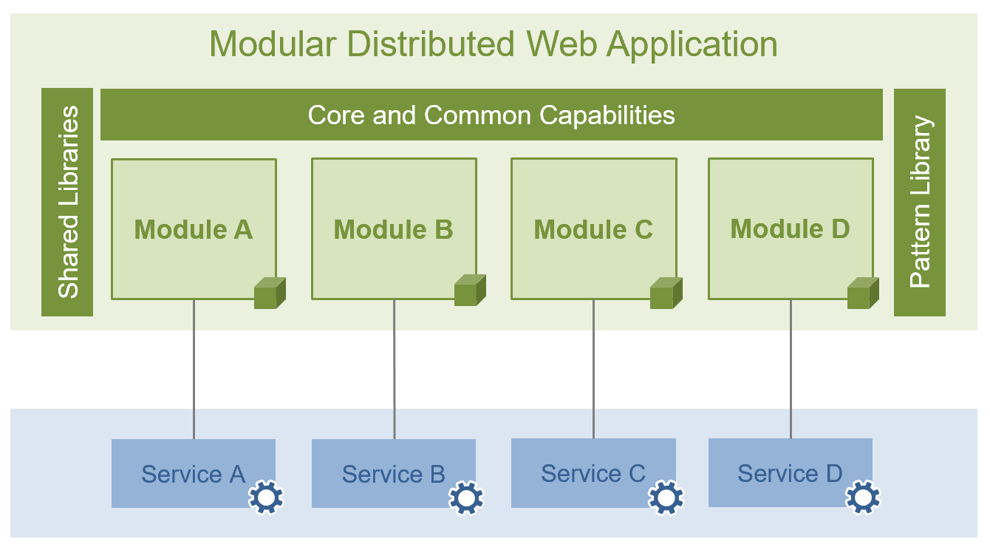
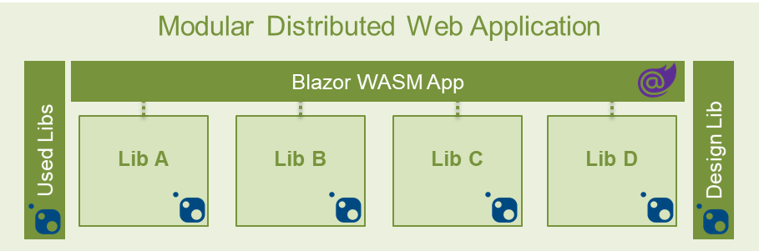

Conclusion
Micro Frontend
Architecture
Architecture for
Distributed Blazor
Framework for
Modular Microfrontends

Slide 30



Thank you!
smapiot
smapiot.com
github.com/smapiot
Florian Rappl
florian.rappl@smapiot.com
@FlorianRappl
Piral
piral.io
docs.piral.io
(in preparation / mid 2021)

